Slide 1


Data Analysis Craft Beer: Breweries, ABV/IBU and Other Statistics Prepared by the Cerberus Company Video: https://www.youtube.com/watch?v=D26nm6r8GuE

Slide 2

Problems to Solve
A list of all craft beers and US breweries was provided. Display the number or breweries in every US State.
Data was merged into a single file, combining beer names with their respective brewers.
After merging the list of craft beers and breweries, eliminate records with missing (N/A) values.
Calculate and display the median alcohol content (ABV) and median international bitterness unit (IBU) for each state
Report which state has the maximum alcoholic (ABV) beer? Which state has the most bitter (IBU) beer?
Review the summary statistics and distribution of the ABV variable.
Is there any relationship between the bitterness of the beer and its alcoholic content? Draw a scatter plot and determine any potential relationship.
Is there any he difference with respect to IBU and ABV between IPAs and other types of Ale. Provide statistical evidence one way or the other.
Recommendations??

Slide 3
Breweries per US State The Number of Breweries In Every US State

Slide 4
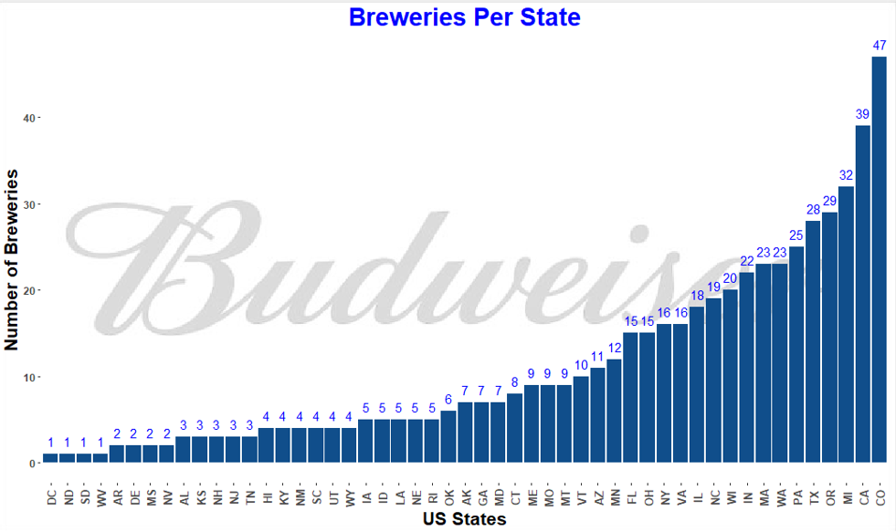
Top 10 states combined contain >50% of all US breweries
Large number of breweries in West (CO, CA, WA, OR)

Slide 5
Missing Values Dealing with Missing Data

Slide 6
Missing Data
To ensure statistical accuracy, we have decided to remove any data sets that were missing ABV or IBU values. These do not represent full data points for the purpose of the ABV / IBU analysis.
This does result, however, in us removing a beer that would have been reported as the max ABV (Colorado). Since this did not have an associated IBU, we are not considering this data point for our analysis

Slide 7
Measure of Center Median IBU and ABV

Slide 8
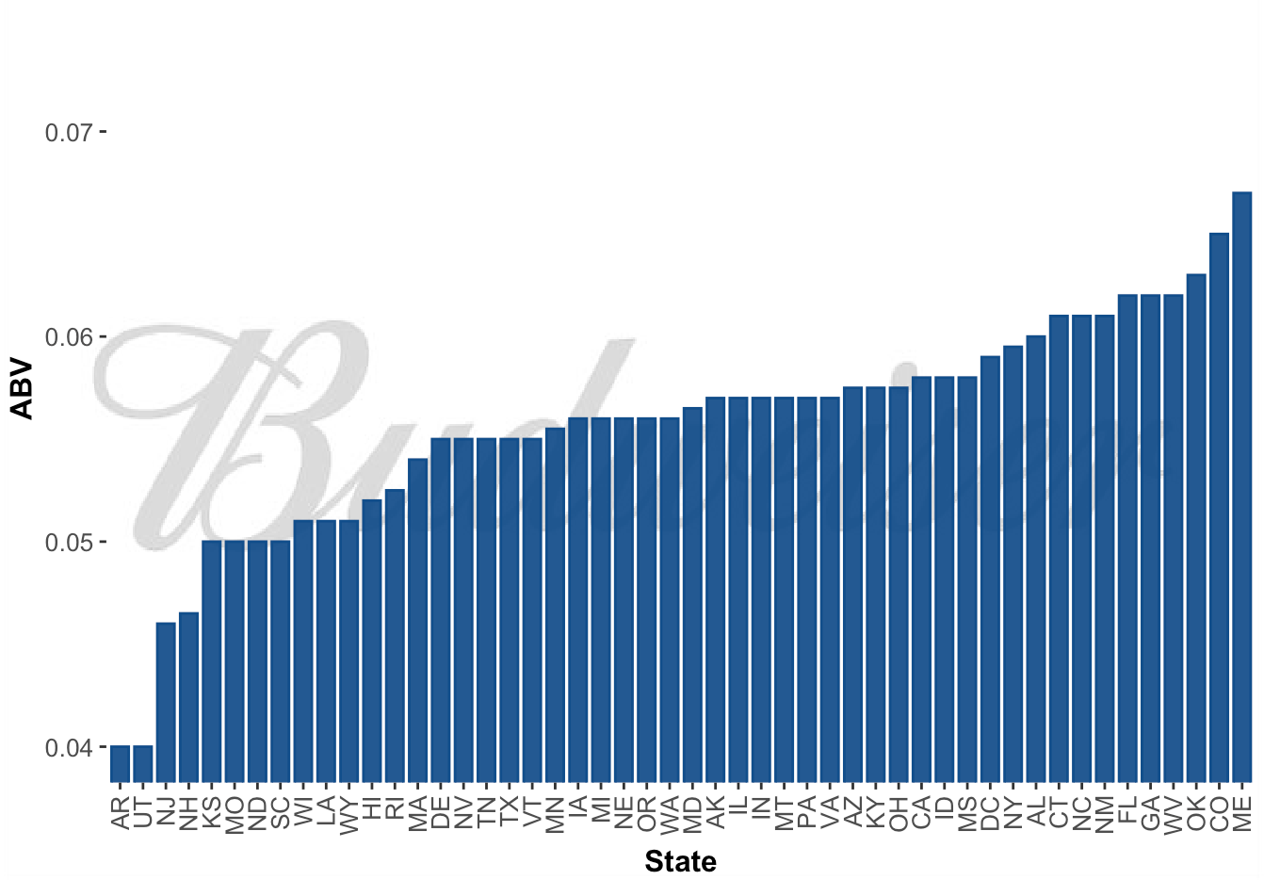
Median Alcohol Content and International Bitterness by State

Slide 9
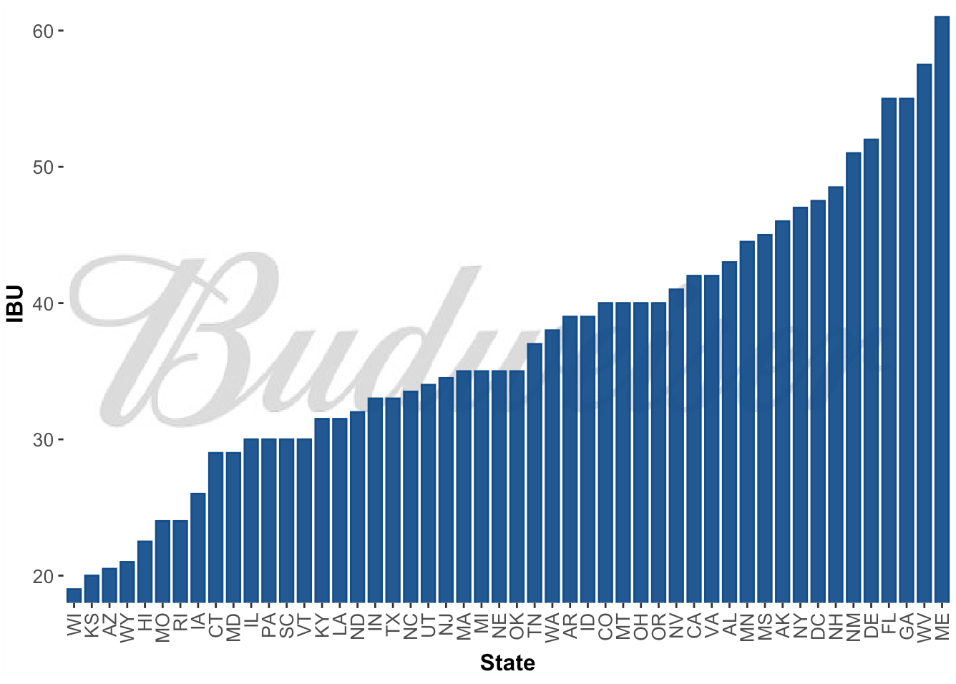
Median Alcohol Content and International Bitterness by State

Slide 10
Maximum IBU and ABV

Slide 11
Oregon’s Astoria Brewing Company out of Astoria has the Bitter Bitch Imperial IPA with 138 IBUs; the most bitter beer from our analysis data.
Kentucky’s Against the Grain Brewery out of Louisville has the London Balling English Barleywine with an ABV of 12.5%; The highest ABV beer from our analysis data.
Note: Colorado’s UpSlope Brewing Company out of Boulder has the Lee Hill Series Vol. 5 Quadrupel Ale, with an ABV of 12.8%. However, it has no associated IBU, so is not included in our analysis.

Slide 12
ABV Statistical Summary

Slide 13
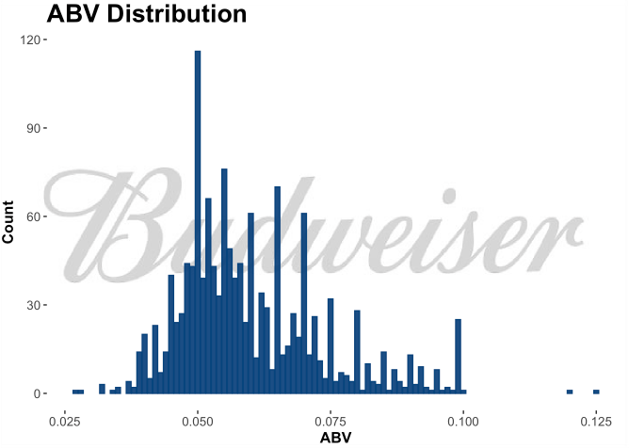
Findings
Evidence of right skewness
Majority of beer falls around the 4.5% - 6% ABV range
Budweiser has an ABV of 5%; falling in the normal range for US Beer

Slide 14
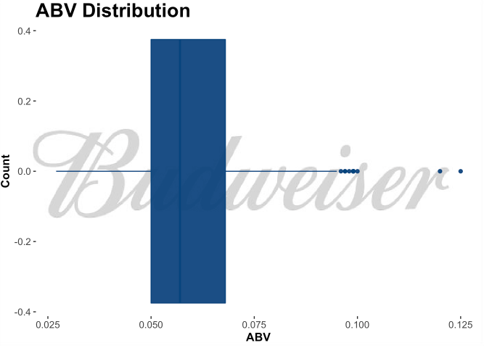
Findings
Min: 2.7%
1st Quartile: 5%
Median: 5.7%
3rd Quartile: 6.8%
Max: 12.5%
Range: 9.8%
Mean: 5.991%
Note: Summary statistics based on beer data with complete ABV/IBU documentation. Beers not completely documented are not included in these findings.

Slide 15
ABV vs IBU: The Relationship between Alcohol Content and Bitterness

Slide 16
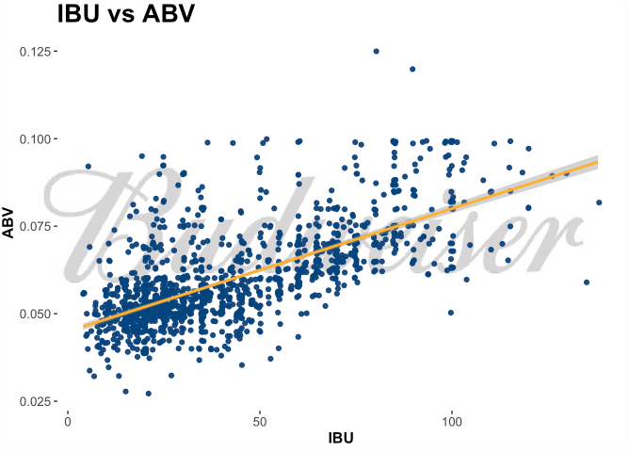
Findings
There is evidence of positive correlation between bitterness (IBU) and alcohol content (ABV).
In general, as IBU increases, an increase in ABV is observed.
Budweiser Beer also follows this trend:
Bud Light 8 IBU, 4.1%
Budweiser 7 IBU, 5% ABV
Black Crown 12 IBU, 6% ABV

Slide 17
IPA vs Ales kNN Modeling to Analyze IBU and ABV trends

Slide 18
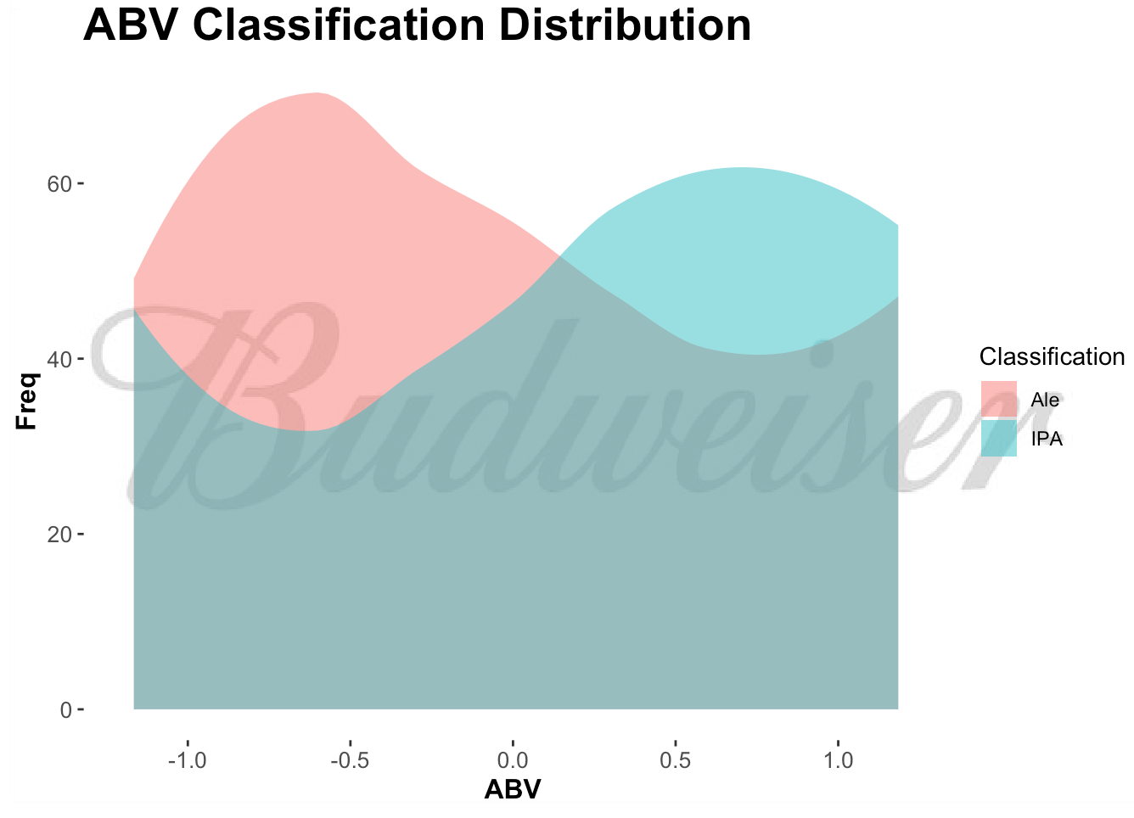
Findings
Optimized kNN Model tended to classify less alcoholic beer as Ale, and more alcoholic beer as IPA.
Conclusion: IPAs tend to have a higher alcohol content than Ales.

Slide 19
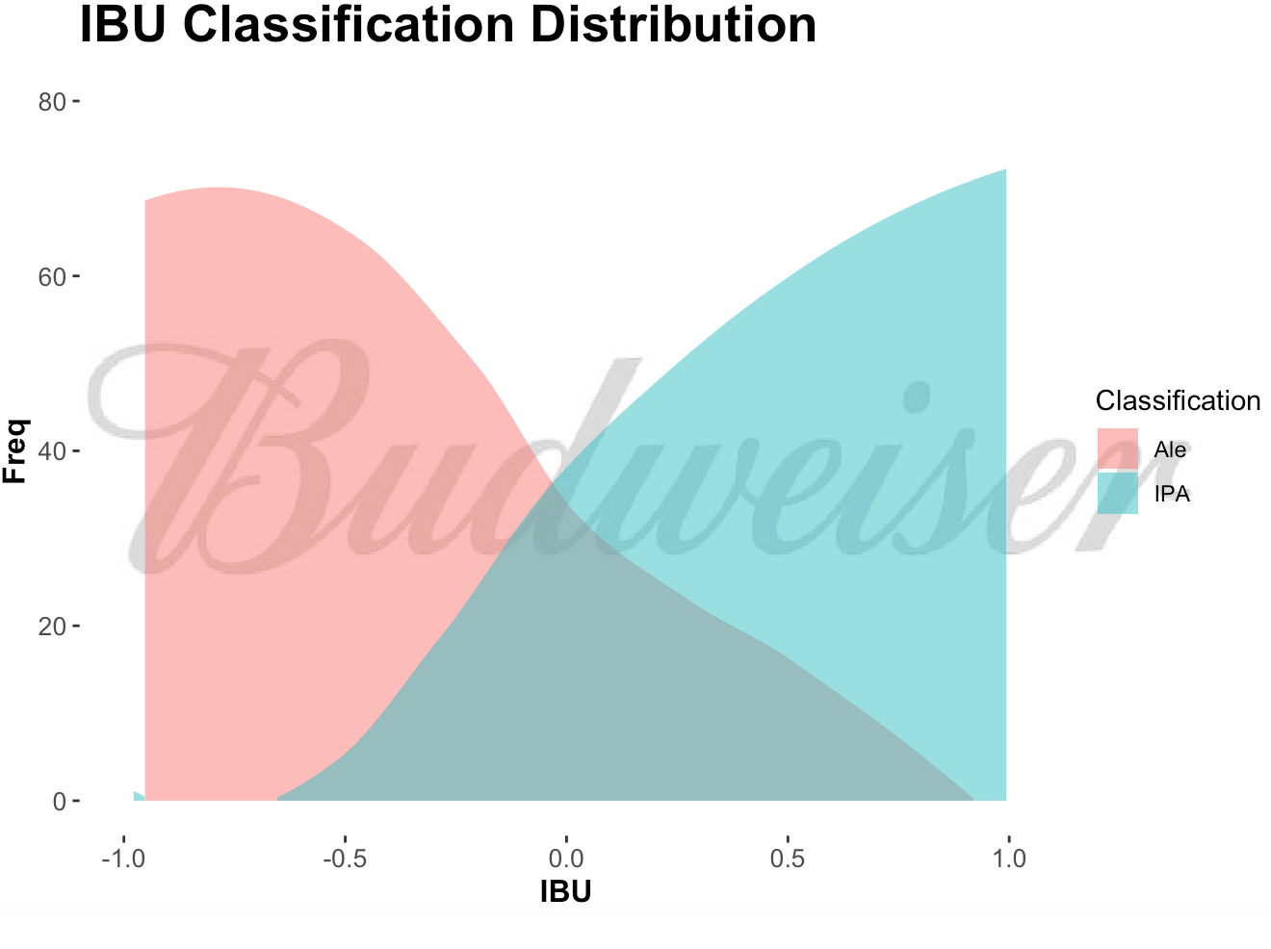
Findings
Optimized kNN model favored IPA classifications for more bitter beer.
Conclusion: IPAs tend to have higher IBU counts, while Pale Ales tend to have lower.

Slide 20
Recommendations: Moving Beyond the Data

Slide 21
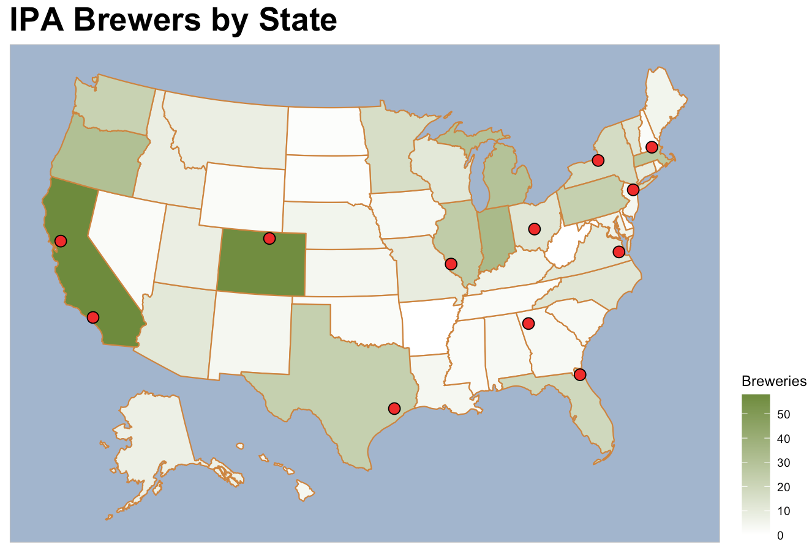
Notes:
Findings
Markets in California and Colorado locations appear oversaturated - it may not make sense to introduce a new Budweiser IPA into these brewing locations
The Texas, Midwest, New England, and Virginia locations all have moderate counts of IPA breweries in the area. This may indicate interest in IPAs by the local populace, and it may be worth investigating further to see if it makes sense to introduce a Budweiser IPA.
The Georgia and Florida Budweiser Breweries are in an area where wither there are almost no IPA breweries, or they are adjacent to this market. It would be worth investigating demand for IPAs in this area. If it exists, it would be strongly recommended to introduce a new Budweiser IPA into these locations to take advantage of this opportunity.

Slide 22
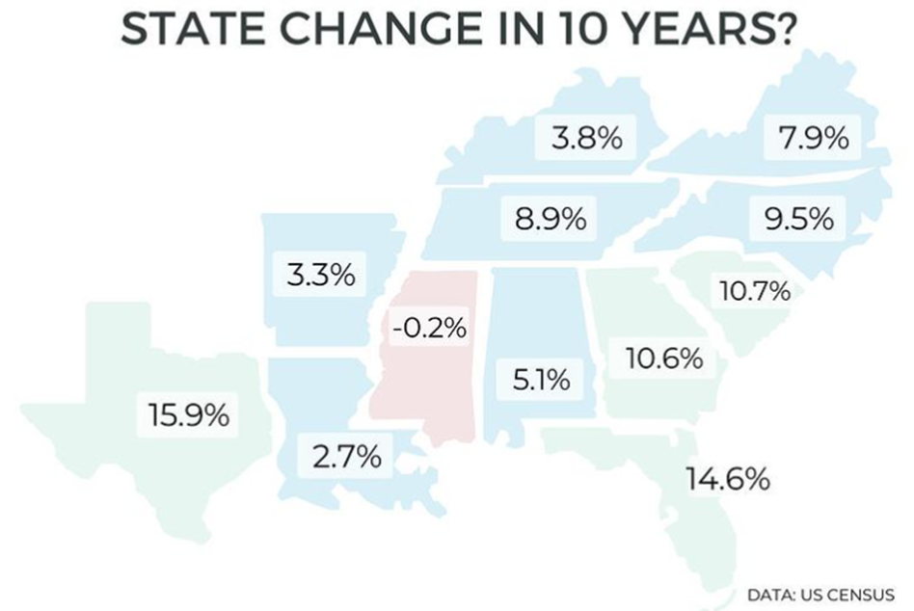
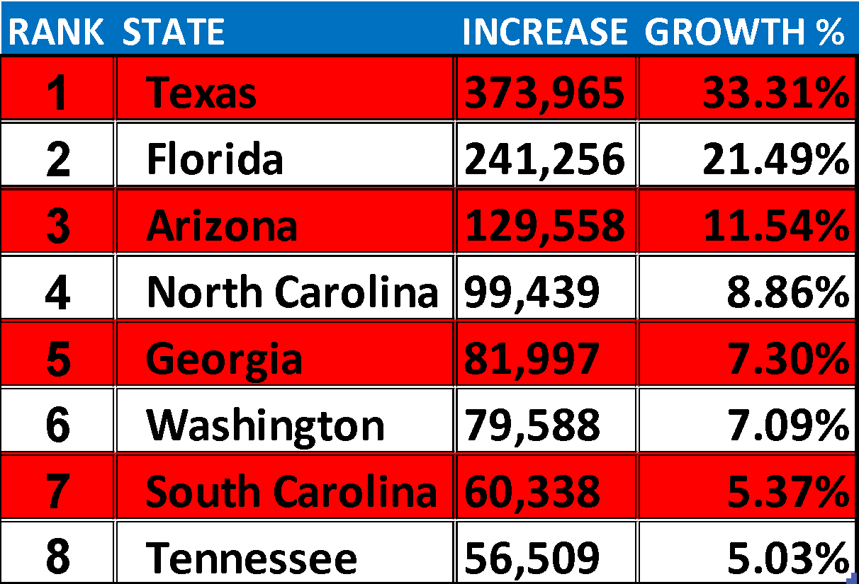
Southeastern states (NC, SC, GA, FL, TN) have all seen strong growth in the past 10 years for a variety of reasons:
Booming housing market – more $$ per sq ft
Lower cost of living
Reduced tax burden
This trend has continued through the pandemic, as Southeastern states continue to show significant growth
STATE GROWTH: JUL ‘20 – JUL ‘21
✰
✰
✰
✰
✰
DATA: https://www.census.gov/

Slide 23
Corporate Tax Rates by State
Doing Business in the Southeast also makes financial sense – these states have among the lowest corporate tax rates in the country
STATE | CORP TAX RATE | RANK
Nevada | 0.00% | 1
Ohio | 0.00%
South Dakota | 0.00%
Texas | 0.00%
Washington | 0.00%
Wyoming | 0.00%
North Carolina | 2.50% | 2
Missouri | 4.00% | 3
North Dakota | 4.31% | 4
Florida | 4.46% | 5
Colorado | 4.63% | 6
Arizona | 4.90% | 7
Utah | 4.95% | 8
Kentucky | 5.00% | 9
Mississippi | 5.00%
South Carolina | 5.00%
Indiana | 5.50% | 10
Georgia | 5.75% | 11
New Mexico | 5.90% | 12
Michigan | 6.00% | 13
Oklahoma | 6.00%
Virginia | 6.00%
Hawaii | 6.40% | 14
Alabama | 6.50% | 15
Arkansas | 6.50%
New York | 6.50%
Tennessee | 6.50%
West Virginia | 6.50%
✰
✰
✰
✰
✰
DATA: taxfoundation.org

Slide 24
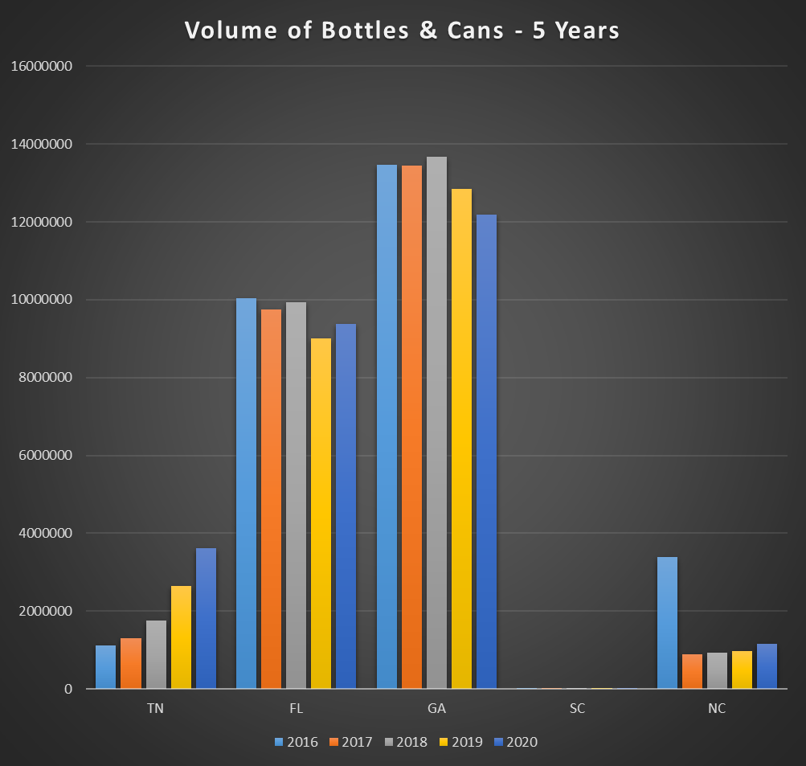
Taxable Volume of Bottles and Cans
While TN has seen a significant growth in the volume of bottles and cans over the past 5 years, GA and FL have the highest current capacity
DATA: Alcohol and Tobacco Tax and Trade Bureau (US Dept of the Treasury)

Slide 25
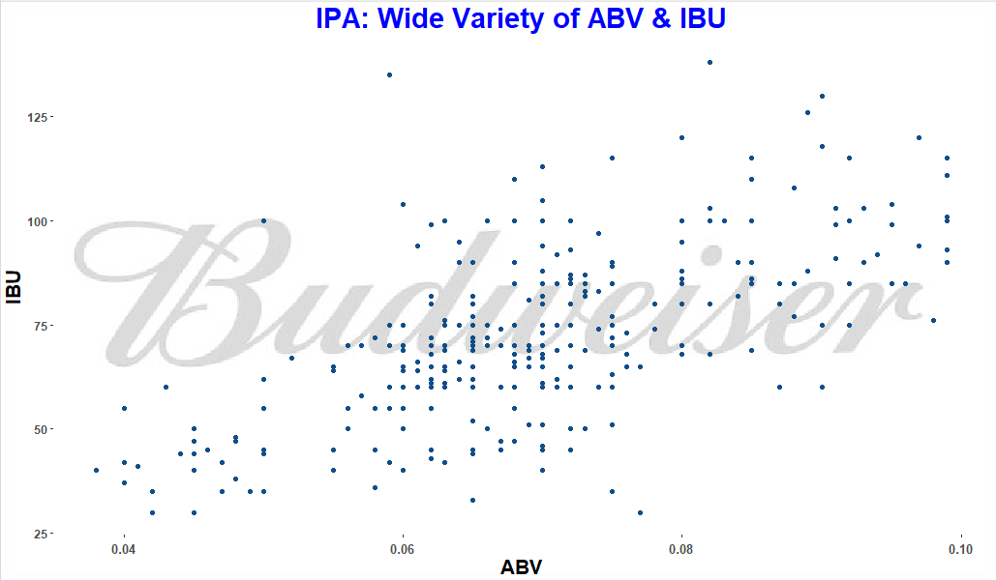
IPA – King of Craft Beer Styles
Largest share of Craft Beer sales
For the calendar year ending December 27, 2020, sales of craft IPAs in retail stores surged 20%, while total craft beer volume grew 13% (IRI)
With a wide range of National ABV/IBU values, IPAs are able to appeal and adapt to the varied tastes of consumers

Slide 26
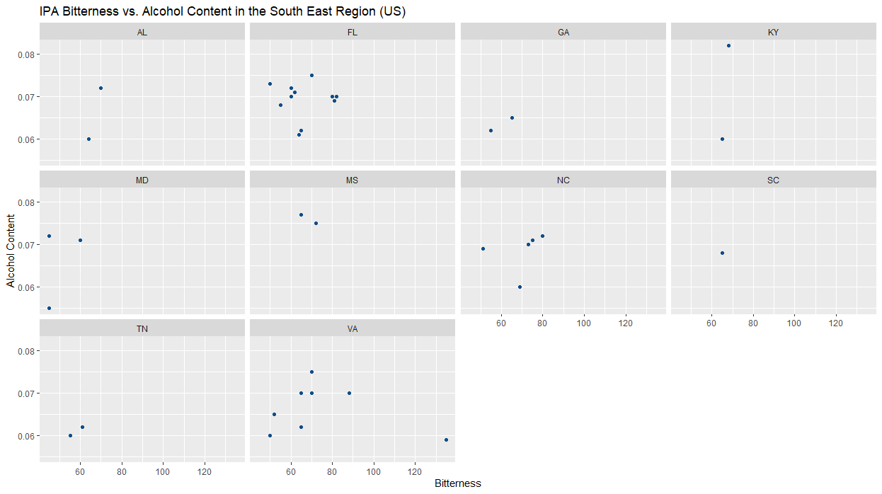
IPA – King of Craft Beer Styles
The Southeast Region of the United States is lacking in options for an IPA

Slide 27
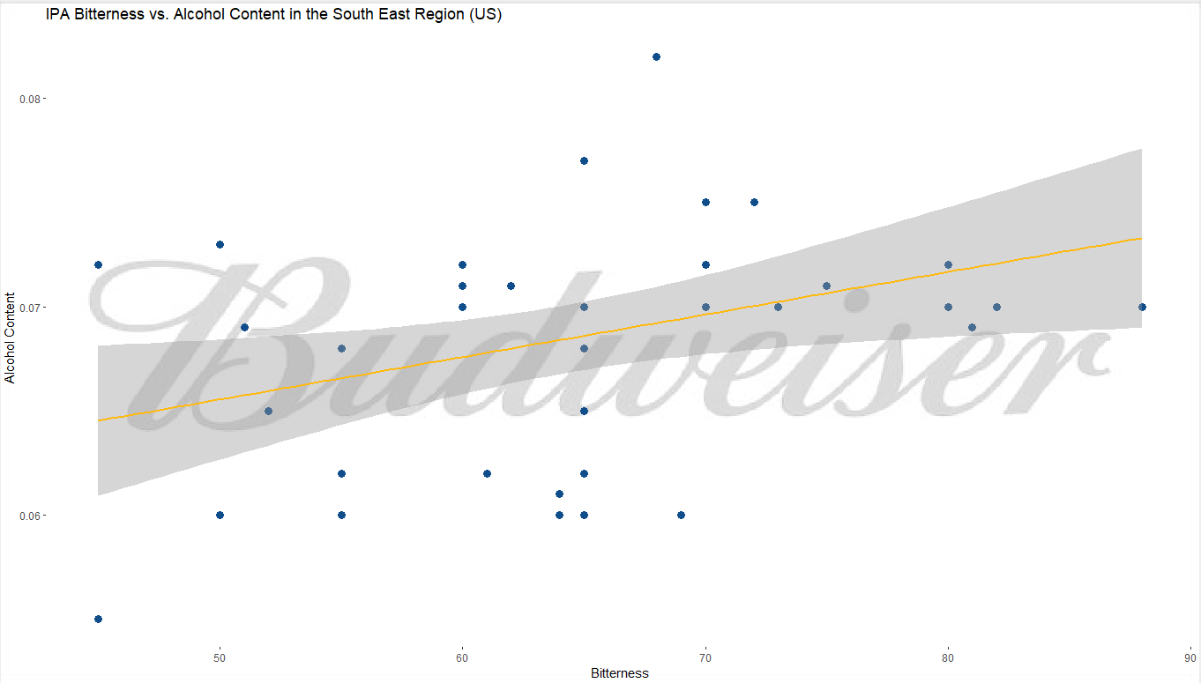
IPA – King of Craft Beer Styles
The following demonstrates ABV vs IBU for IPAs in the Southeast Region
Note: Wolf Hills Brewing Company’s Troopers Alley IPA was considered an outlier with an IBU of 135 and removed from the plot

Slide 28
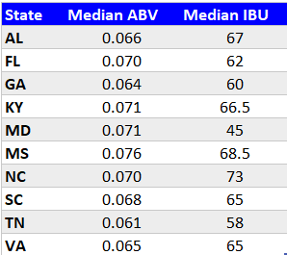
IPA – King of Craft Beer Styles
The table shows the median ABV and IBU by state
The overall median ABV is 0.07
The overall median IBU is 65

Slide 29
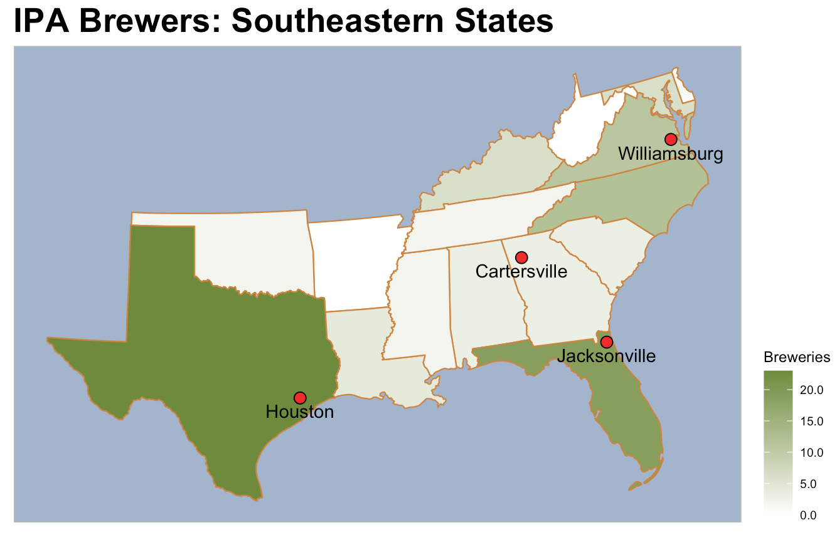
Notes:
Population is growing rapidly in the Southeast region
Southeast states are business-friendly, with lower Corporate tax rates
Georgia and Florida have a high volume of beer (bottles & cans)
IPAs are a popular and growing segment within the Craft Beer industry
Budweiser has existing breweries in Georgia & Florida today
Budweiser currently produces some IPAs, options are lacking in the SE
Combine existing synergies, take advantage of regional advantages: Expand IPA production in Georgia and/or Florida to market to the Southeast region…and beyond

Slide 30
Recommendation: Pulling it all Together
Population is growing rapidly in the Southeast region
Southeast states are business-friendly, with lower Corporate tax rates
Georgia and Florida have a high volume of beer (bottles & cans)
IPAs are a popular and growing segment within the Craft Beer industry
Budweiser has existing breweries in Georgia & Florida today
Budweiser currently produces some IPAs, options are lacking in the SE
Combine existing synergies, take advantage of regional advantages: Expand IPA production in Georgia and/or Florida to market to the Southeast region…and beyond

Slide 31
Thank you for your time! Questions?

